Slide 1
WOODEN BOX PROJECT – YEAR 9
DESIGN BRIEF
You have been asked to design and make a decorative wooden box to store small items - jewellery etc.
The box should not exceed maximum dimensions of 250mm x 250mm x 150mm and must be made predominantly from timber, although metal or plastic could be incorporated.

Slide 2
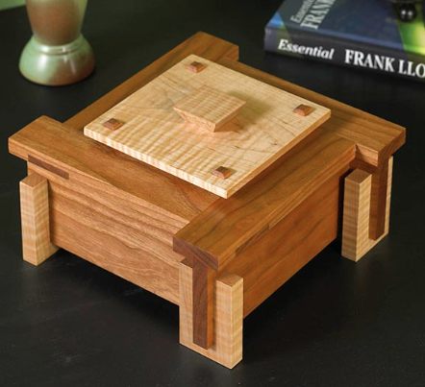
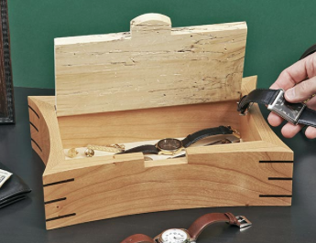
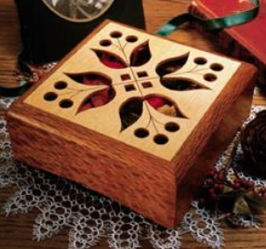
WOODEN BOX PROJECT – YEAR 9

Slide 3
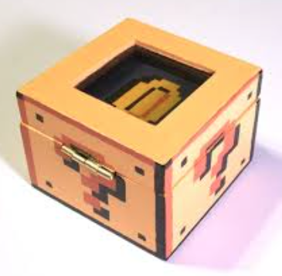
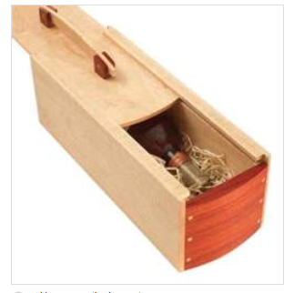
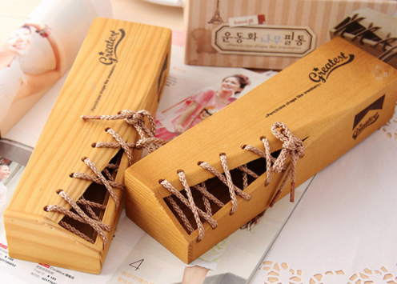
WOODEN BOX PROJECT – YEAR 9

Slide 4
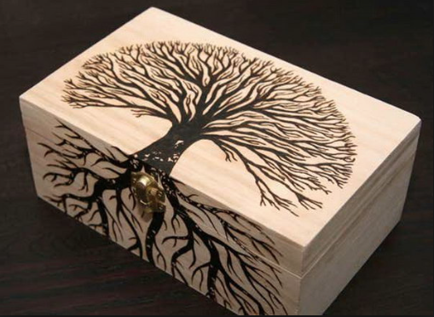
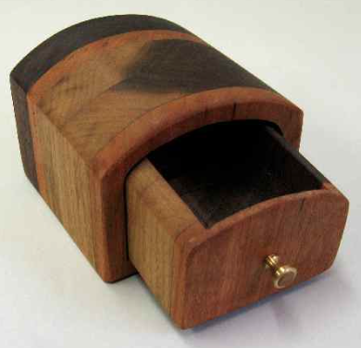
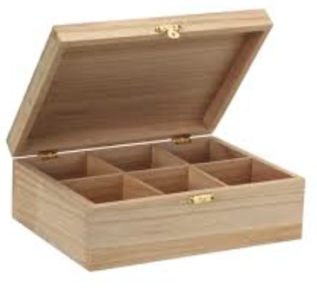
WOODEN BOX PROJECT – YEAR 9

Slide 5
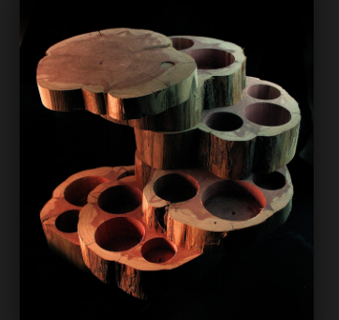
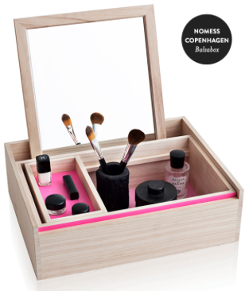
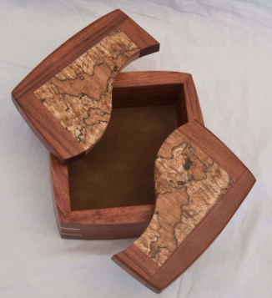
WOODEN BOX PROJECT – YEAR 9

Slide 6
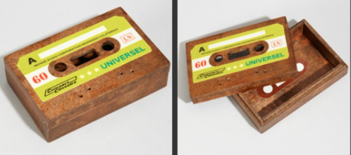
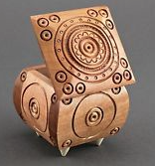
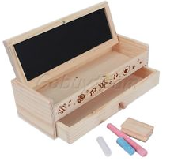
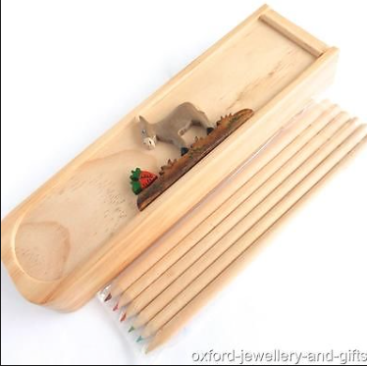
WOODEN BOX PROJECT – YEAR 9

