Slide 1
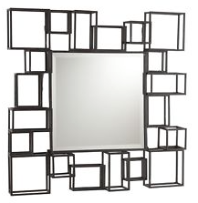
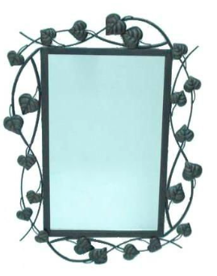
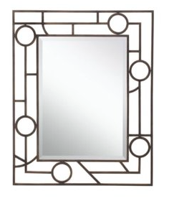
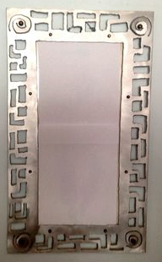
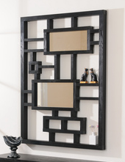
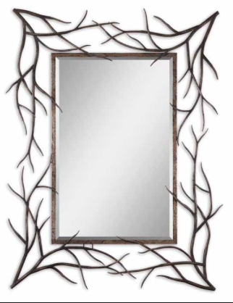
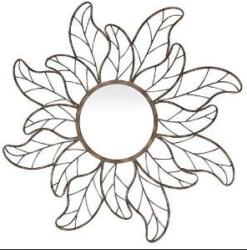
MIRROR PROJECT YEAR 10
MATERIALS, DESIGN AND TECHNOLOGY
NAME -

Slide 2
PROJECT BRIEF
MATERIALS, DESIGN AND TECHNOLOGY
NAME -
You have been asked to design and make a steel mirror. The mirror must be suitable for use indoors and have a bracket to attach it to a wall. The actual mirror must be no larger than 290x210mm, but the frame can be larger.
DESIGN WORK | grade descriptors
TASK COMPLETED | VERY POOR, LIMITED EFFORT | A GOOD START BUT MORE EFFORT REQUIRED | GOOD WORK | VERY GOOD WORK | EXCELLENT, A HIGH STANDARD OF WORK | A percentage for each piece of work will be given to all students based on the grid opposite, the percentages relate to the following grades: Grade A - over 80% Grade B - 65 - 79% Grade C - 50 - 64% Grade D - 35 - 49% Grade E - 34% or less
research and analysis | 1 | 2 | 3 | 4 | 5
initial design ideas | 1 | 2 | 3 | 4 | 5
quality of presentation | 1 | 2 | 3 | 4 | 5
final design idea | 1 | 2 | 3 | 4 | 5
plan of manufacture | 1 | 2 | 3 | 4 | 5
evaluation | 1 | 2 | 3 | 4 | 5
 |  |  |  | final grade | /30
PRACTICAL WORK | grade descriptors
performance within the workshop | some safety issues within the workshop | reluctant to use the workshop equipment | worked well but needs to gain confidence | very good practical skills within the workshop | very confidant, excellent practical skills
 | 1 | 2 | 3 | 4 | 5
overall product | a poor effort | some good work, but more focus needs to be placed on achieving a better quality finish | a good product but more attention to detail required | a high quality product, with slight finishing issues | an excellent, high quality product with a high quality finish
 | 7 | 14 | 21 | 28 | 35
suitability of the product | unsuitable design | some features of the design are suitable | a good design with some suitability issues | a very suitable design with slight design issues | an excellent design which meets the brief well
 | 6 | 12 | 18 | 24 | 30
 |  |  | Final grade for practical work |  | /70
Teacher comments and final mark

Slide 3
EXISTING PRODUCTS
MATERIALS, DESIGN AND TECHNOLOGY
NAME -
Select 4 examples of existing metal mirrors and analyse them using the ACCESS FM scale
Place your existing product picture here
Place your existing product picture here
Place your existing product picture here
Place your existing product picture here

Slide 4
DESIGN IDEAS
MATERIALS, DESIGN AND TECHNOLOGY
NAME -
Below complete sketches of six possible design ideas for your mirror. Annotate by answering these questions about each design – Good points, Bad points, what improvements could you make?

Slide 5
FINAL DESIGN
MATERIALS, DESIGN AND TECHNOLOGY
NAME -
Below complete a 3D drawing of your final mirror design, it can be completed on Google Sketchup if you wish. This drawing should include all measurements.. This is your working drawing so it must be very HIGH quality.

Slide 6
METHOD OF MANUFACTURE
MATERIALS, DESIGN AND TECHNOLOGY
NAME -
Below complete a detailed account of how you have manufactured your mirror. You should aim to include all materials, processes and techniques.
 | list all tools, equipment, materials and processes you have used.
lesson 1
lesson 2
lesson 3
lesson 4
lesson 5
lesson 6
lesson 7
lesson 8
lesson 9
lesson 10
lesson 11
lesson 12
lesson 13
lesson 14
lesson 15
lesson 16
lesson 17
lesson 18
lesson 19
lesson 20
 | list all tools, equipment, materials and processes you have used.
lesson 21
lesson 22
lesson 23
lesson 24
lesson 25
lesson 26
lesson 27
lesson 28
lesson 29
lesson 30
lesson 31
lesson 32
lesson 33
lesson 34
lesson 35
lesson 36
lesson 37
lesson 38
lesson 39
lesson 40

Slide 7
EVALUATION
MATERIALS, DESIGN AND TECHNOLOGY
NAME -
Below complete a full evaluation of your product
Place photo of final
product here.

